Slide 1

Medical E Card System
By Karan Saji
Suraj Vishwakarma
Shikshita Yadav
Disha Waghmare

Slide 2
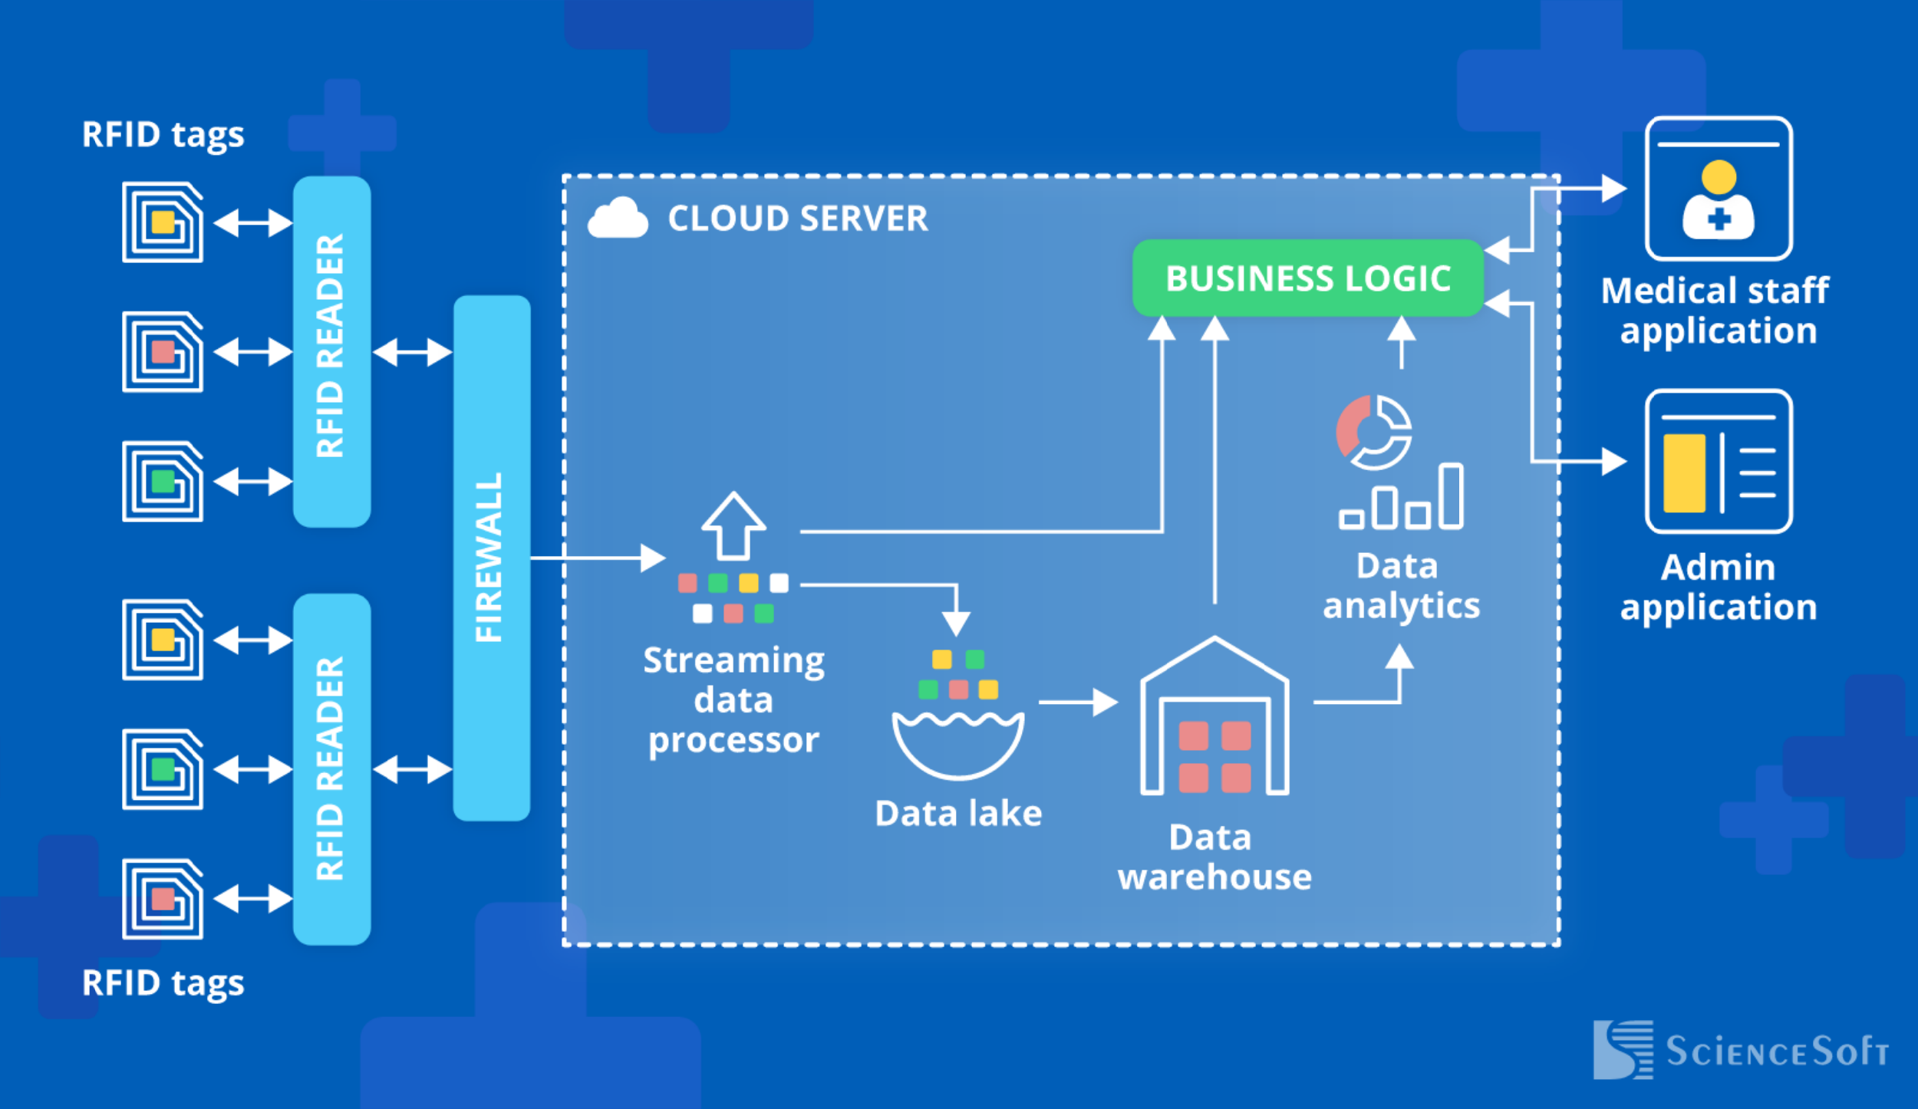
Introduction
If used for hospital asset, medication, patient and staff tracking, RFID technology is bringing benefits by cutting operational costs, streamlining hospital workflows and asset utilization, reducing medical errors, and improving patient safety.

Slide 3

Architecture
RFID tags (active or passive)
RFID readers
Firewall
Streaming data processor
Data lake
Big data warehouse
Data analytics
RFID tracking software business
Staff application
Admin application

Slide 4

ABHA
ABHA is a unique health ID that uses a 14-digit identification number and can be generated using an Aadhaar card or your mobile number. It allows users to share their health records digitally with hospitals, clinics, insurance providers and others.
The benefits of ABHA are as follows –
You can access all your medical records such as lab reports, prescriptions and diagnoses on the platform.
You can use the platform to easily share your medical records with hospitals, clinics and insurance providers.
This will make it easier for you to present your medical records even if you are in a different city or state.

Slide 5

Applications
Medical asset tracking
Medication inventory management
Patient tracking
Medical Staff tracking
Hospital Visitors tracking

Slide 6
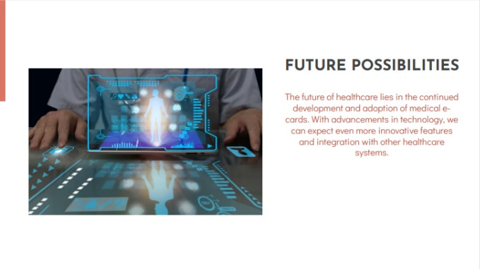
Future Possibilities
The f

Slide 7
